Slide 1
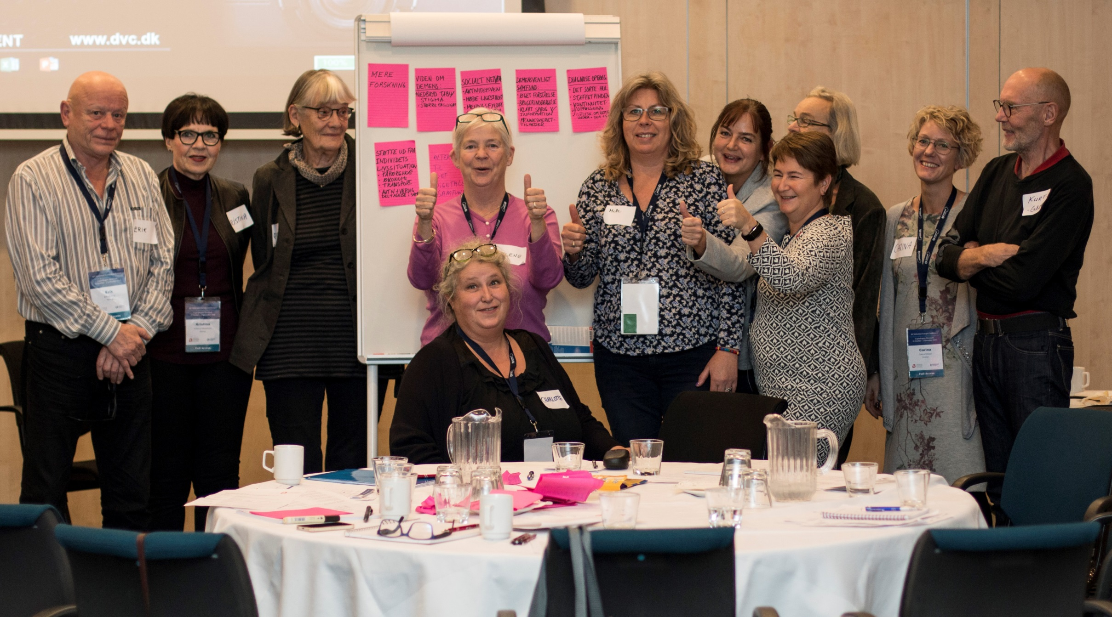



Slide 2
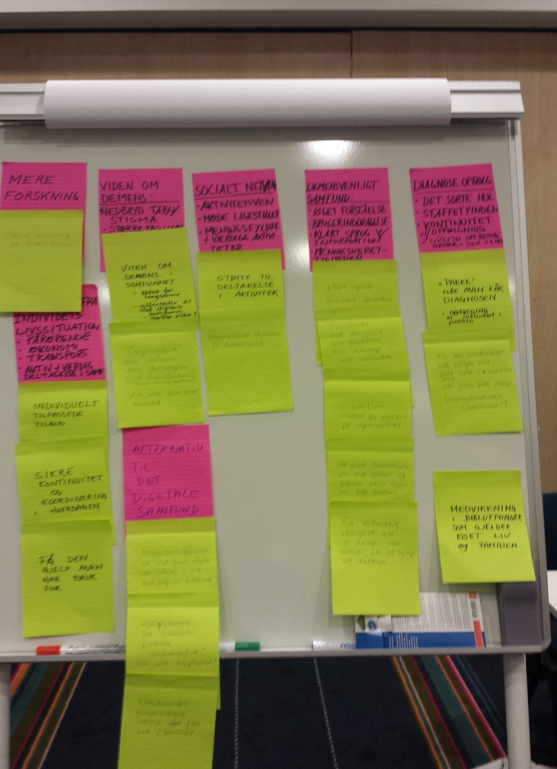

Slide 3

7. Support to remain connected
to the digital society
1. More focus on research
2. More awareness
and knowledge about
dementia in society
Copenhagen
declaration
- Scandinavian voices on
dementia friendly societies
6. Opportunity
to participate in worthy
and meaningful
activities
3. That all countries
become dementia
friendly
5. Person and family centered help and care
4. Systematic post-diagnostic
support and follow up

